Slide 1
Trust, Identity and Access Management
Stefan Wiedemann, Technical Lead & Architect, FIWARE Foundation e.V.

Slide 2
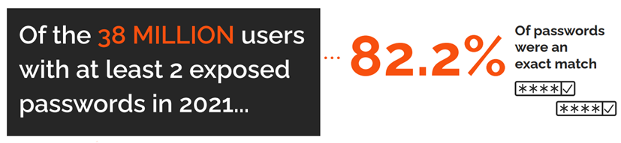

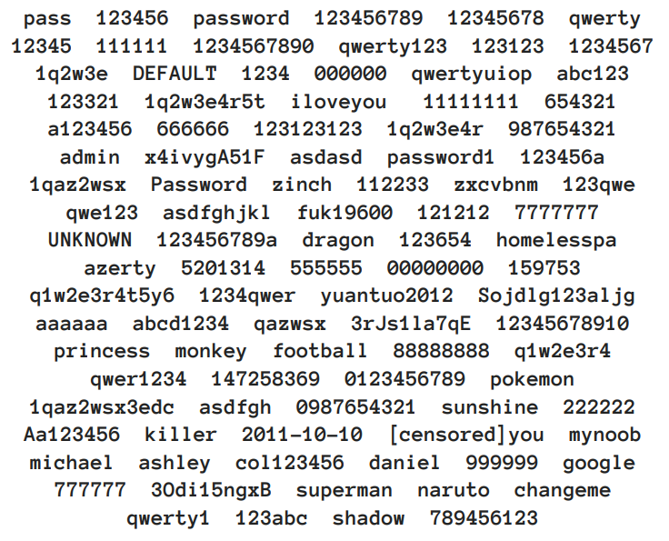

Current models of identification

Slide 3

Current models of identification
Login with XXXX
Easier for citizen and business but provides too much power to the Identity Provider.
Very centralized

Slide 4
Current models of identification
Federated Identity Providers
Like Mobile Connect
or
Banking ID

Slide 5

Back to the future
Copy the good things of the physical world
Augment with digital powers
Preserving the required properties
Adapted to the current legal framework, but prepared for the future one
This Photo by Unknown Author is licensed under CC BY

Slide 6
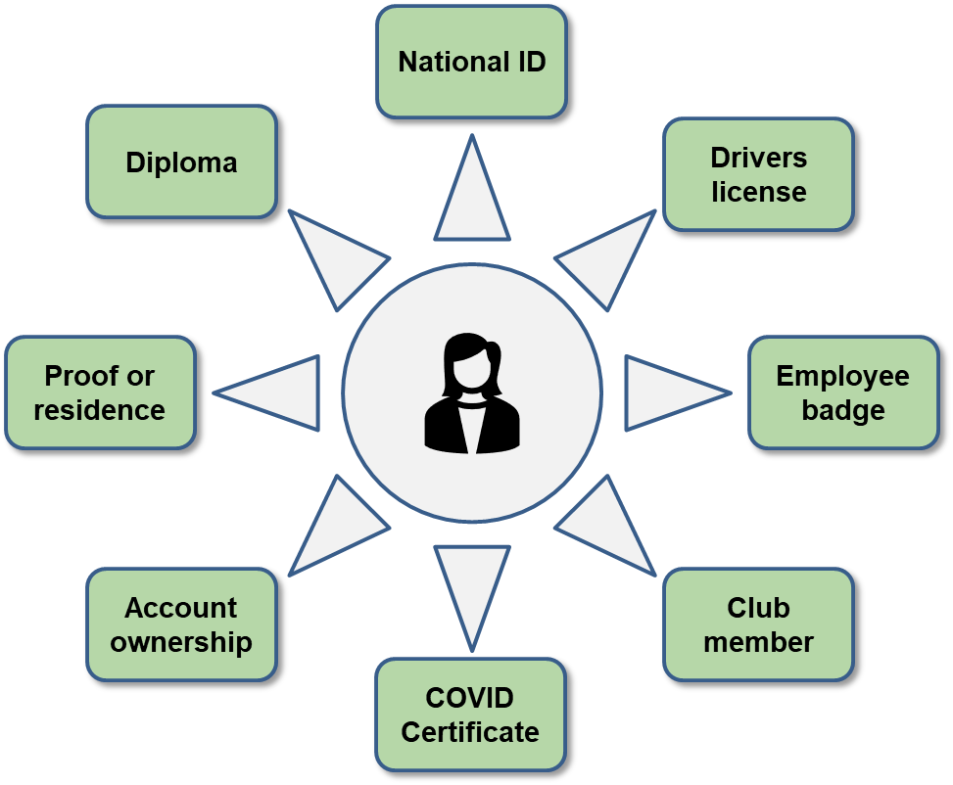
Identity of a natural person

Slide 7
Identity of a juridical person
Business Registry ID
GDPR
LEI ID
TAX compliance
ISO 140xx
Banking Solvency
ISO 5000x
Industry member

Slide 8
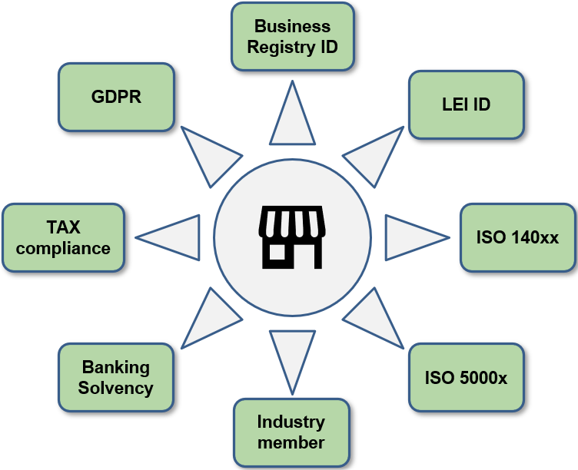
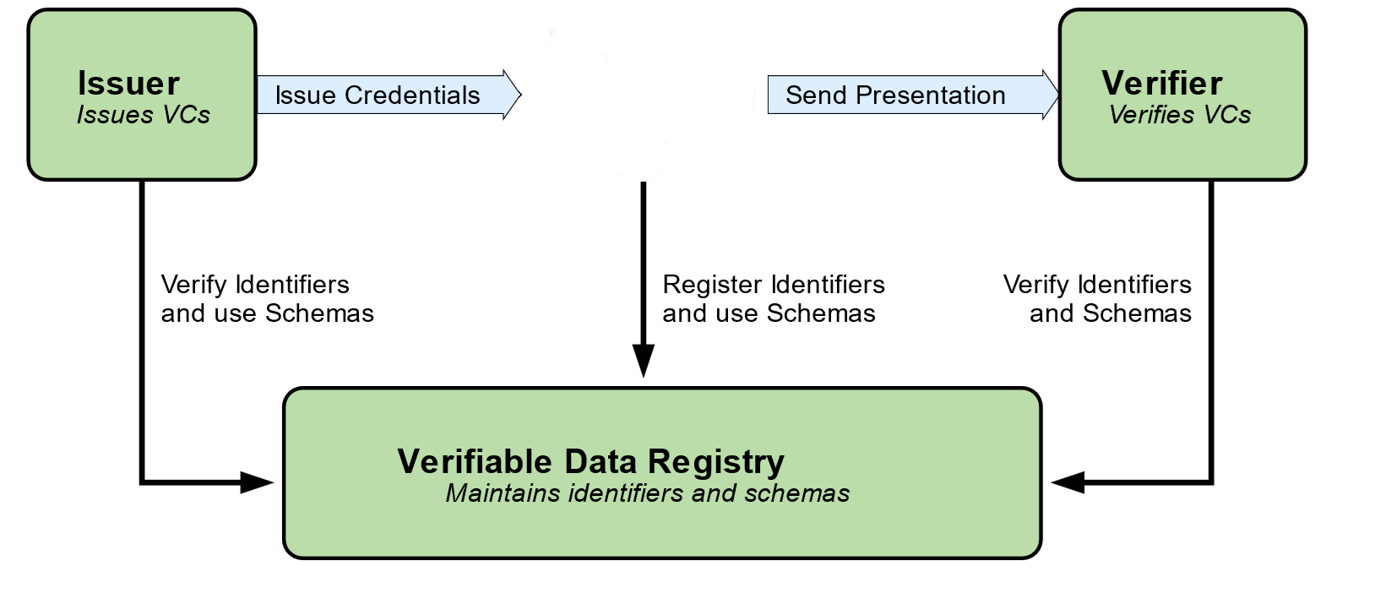
W3C Verifiable Credentials ecosystem

Slide 9
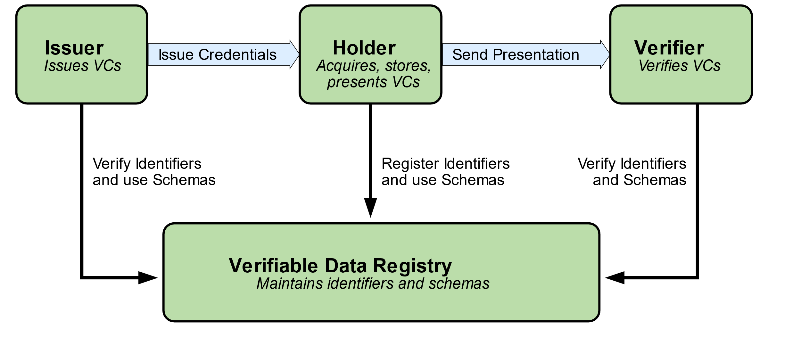
W3C Verifiable Credentials ecosystem

Slide 10
Which credentials and data model for each one

Slide 11
Transport mechanism for credentials

Slide 12
Trust Framework
Trust Framework

Slide 13

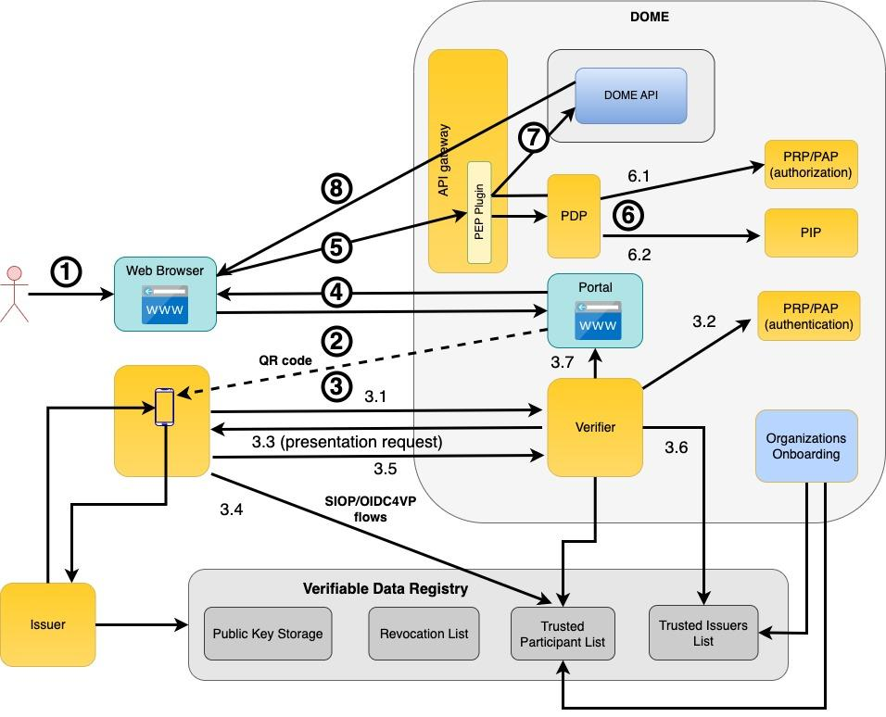


Standards-based Open Source Identification and Authorisation implementation
Decentralised IAM Framework based on W3C Verifiable Credentials.
Avoid centralized identity providers using Self-Issued OpenID Provider v2 (SIOPv2) and enable all participants to send identity data.
Transport VC/VP in the flows of OpenID Connect, using OpenID Connect for Verifiable Presentations (OIDC4VP) leveraging proven, standard and secure mechanisms.
Aligned with EBSI (European Blockchain Services Infrastructure)

Slide 14

Trust Anchor Framework
ID Binding using identifiers in eIDAS digital certificates issued by EU Trust Service Providers (TSP).
Proof of participation using (Decentralized) Trusted Participant List stored in the Verifiable Data Registry.
Proof of issuing authority using one or more (Decentralized) Trusted Issuers Lists stored in the Verifiable Data Registry.
Verifiable Data Registry can be implemented with any technology, but we use APIs based on EBSI and Decentralized Ledger Technology (blockchain/DLT).
eIDAS

Slide 15
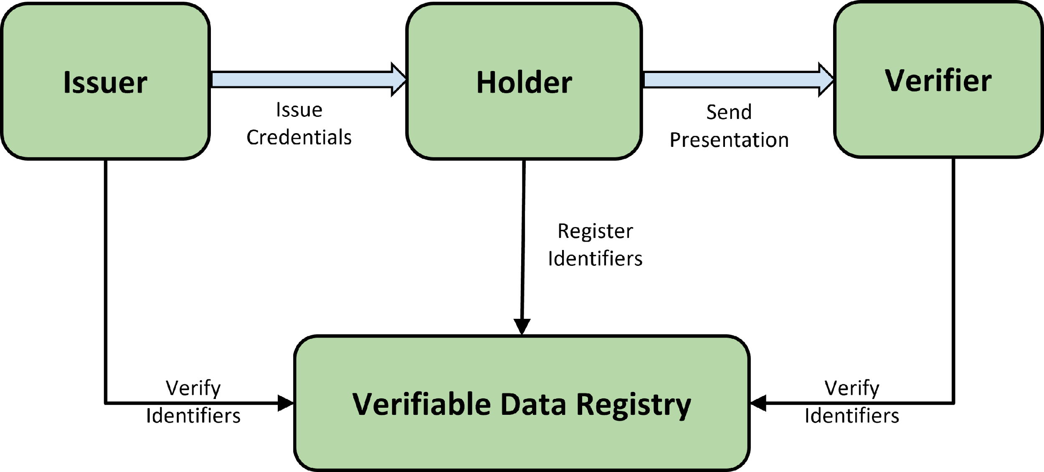
Trust Anchor Framework
ID Binding using identifiers in eIDAS digital certificates issued by EU Trust Service Providers (TSP).
Proof of participation using (Decentralized) Trusted Participant List stored in the Verifiable Data Registry.
Proof of issuing authority using one or more (Decentralized) Trusted Issuers Lists stored in the Verifiable Data Registry.
Verifiable Data Registry can be implemented with any technology, but we propose APIs based on EBSI (European Blockchain Services Infrastructure) and Decentralized Ledger Technology (blockchain/DLT).
eIDAS

Slide 16
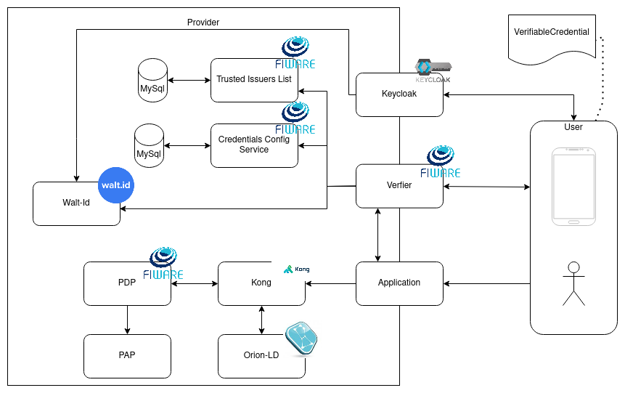
FIWARE Implementation

Slide 17
Further reading
Demo deployment:
https://github.com/FIWARE-Ops/fiware-gitops/tree/master/aws/dsba
The slides: https://github.com/wistefan/presentations

